Slide 1






The Crash of
Terra Luna
Xinyrui Pan & Xinyan Zhao

Slide 2
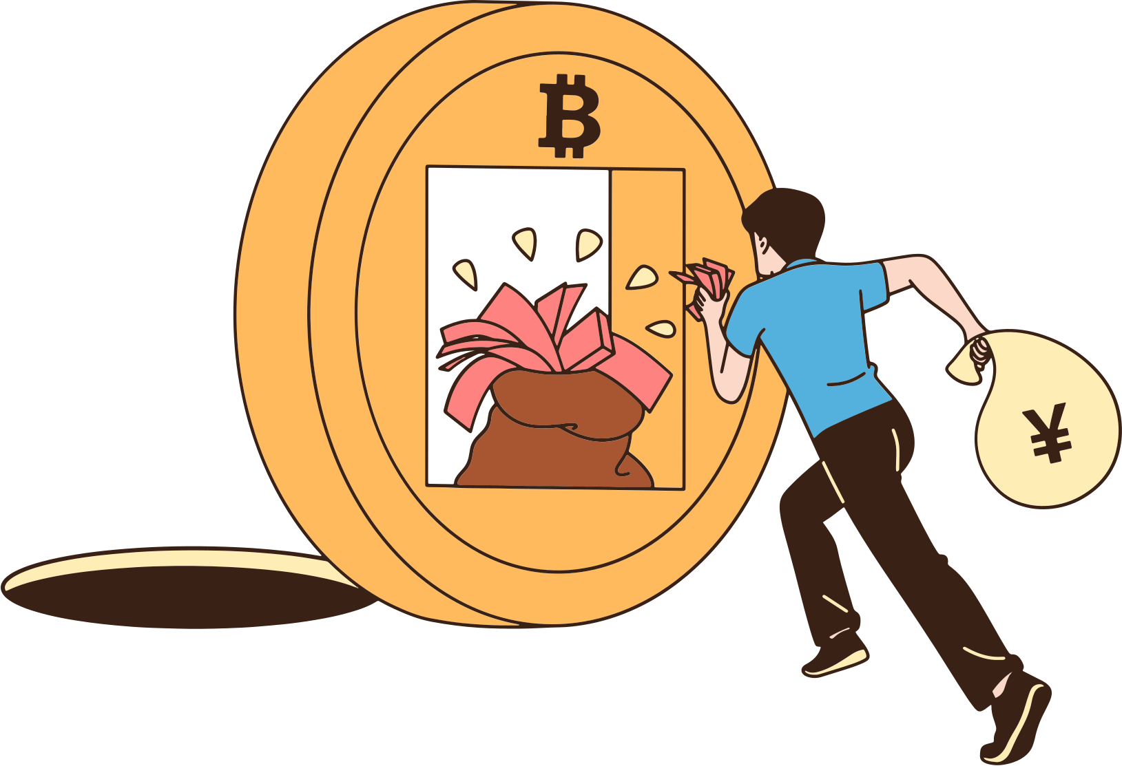
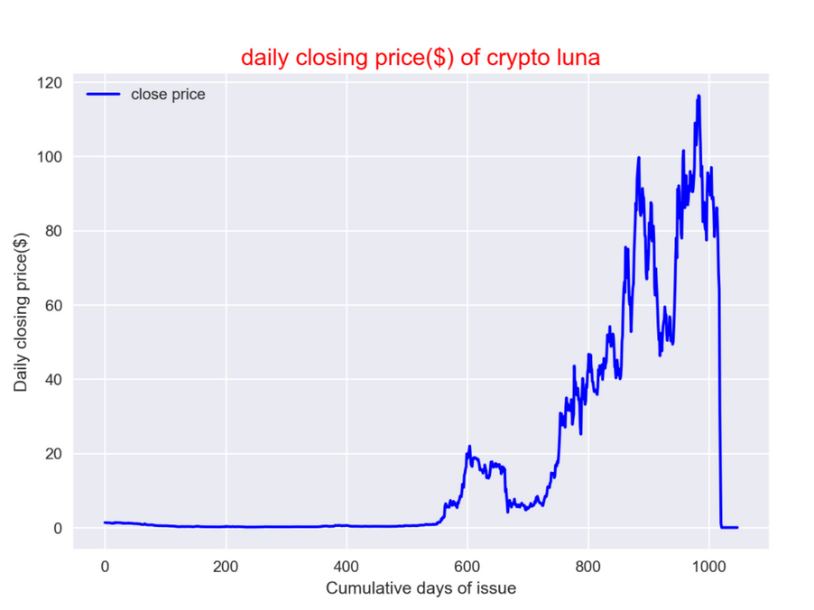
Project
Description
/ Why we choose this topic?
In May, a big thing happened in the virtual currency market : the value of luna coins issued by Terrain plummeted. We are aware of this fact and want to analyze the existing data to find out the reasons behind this fact.

Slide 3


PART 01
DATA SETS WE USED:
1:Data from https://www.kaggle.com/datasets/avanawallet/crypto-price-data-during-terra-luna-crash provide by Avana Wallet
2:The data crawled from here https://app.anchorprotocol.com/
3: Data from https://www.kaggle.com/datasets/programmerrdai/terra-came-back-to-the-ground provide by hrterhrter

Slide 4
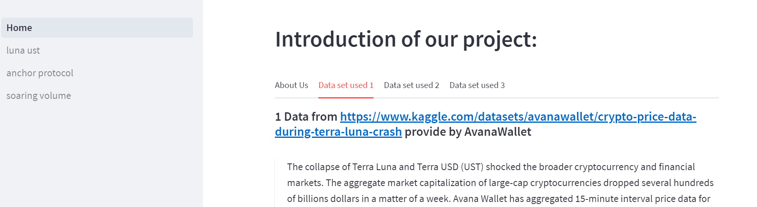
PART 01
DATA SETS WE USED:

Slide 5
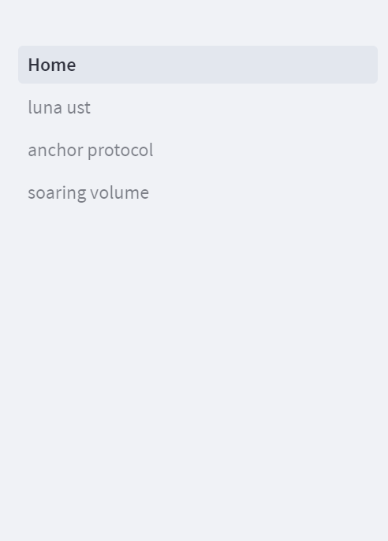
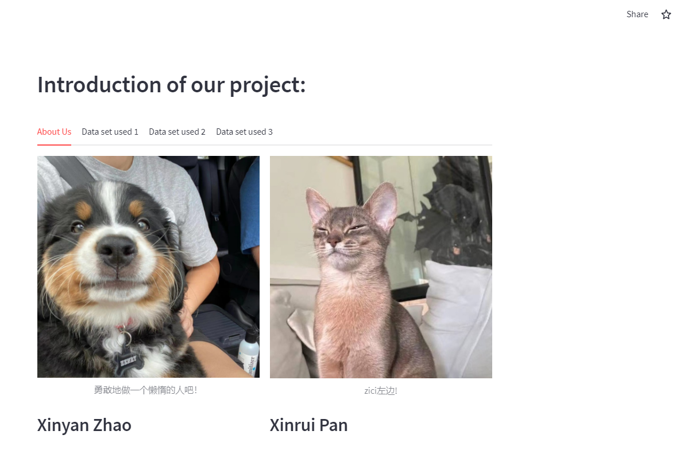
APP DEMO:

Slide 6



Research Content design
Why did Luna crash?

Slide 7


UST & Luna
Bidirectional destruction mechanism
1: One dollar worth Luna = 1 UST
2: Anyone can exchange UST for one dollar worth of Luna, or Luna for one dollar worth of UST.
3: UST can only be redeemed by Luna

Slide 8

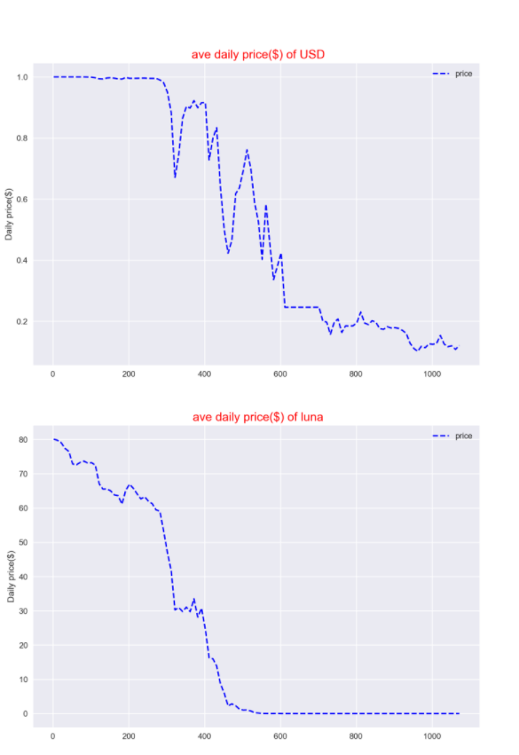

UST & Luna
Daily price of USD and luna during the crash(2022.5.06-2022.5-11)

Slide 9
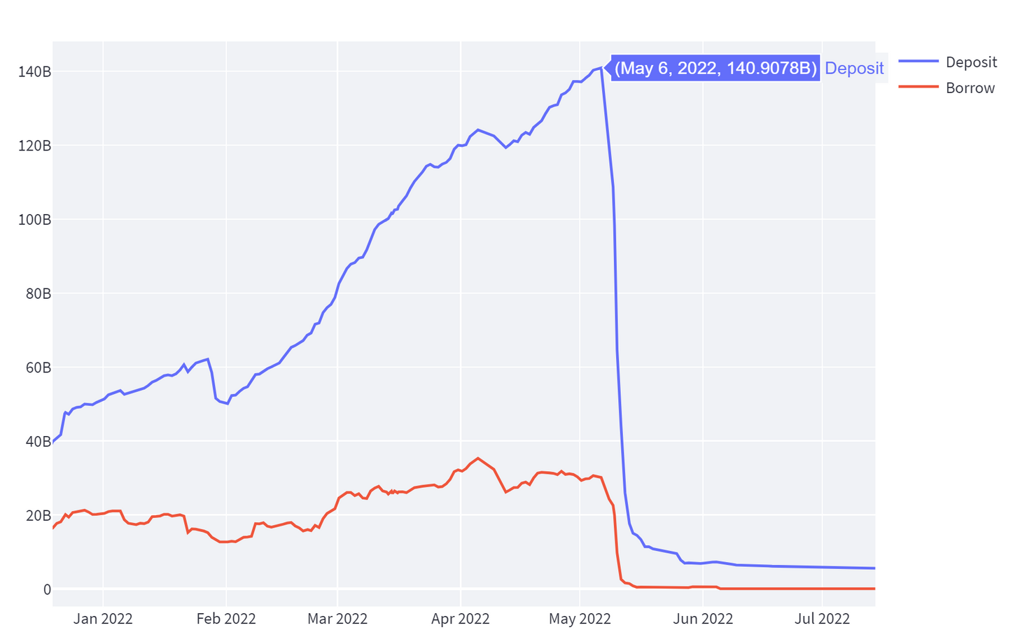
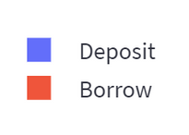
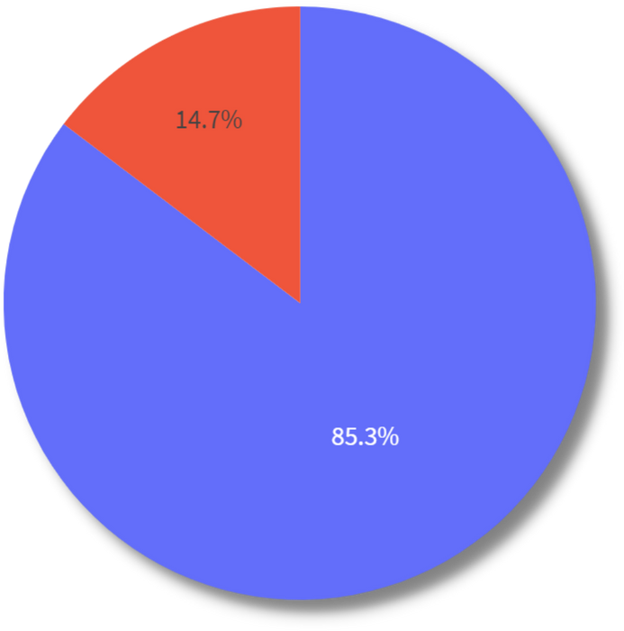
Anchor Protocol
PART 04
20%
INTEREST RATE

Slide 10


Why a run on anchor
contributes to Luna's crash?

Slide 11

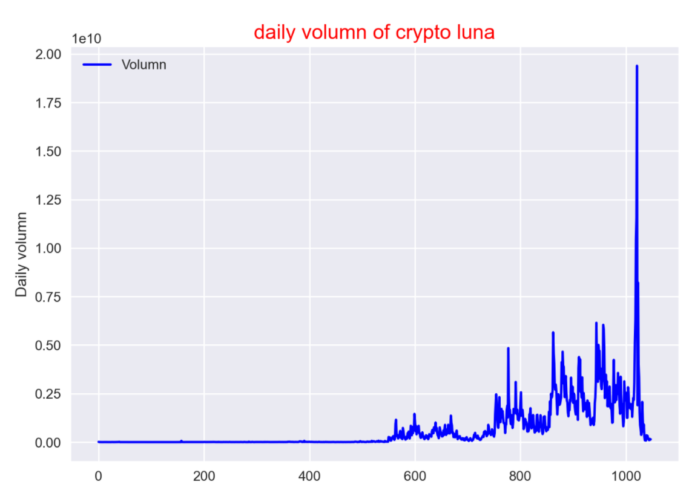

Soaring currency
volume
PART 03
The above operation led to a large number of users converting USD to luna, and the volumn of luna skyrocketed, resulting in rapid depreciation. As the number of luna coins continues to rise, the price continues to fall, finally forming an irretrievable death spiral.

Slide 12



ANALYSIS
A large number of deposits were withdrawn ，and a run occurred.
There are a lot of UST on the market.
UST prices fell (supply and demand) below $1.
A large number of UST were converted to Luna.
luna price drop.
UST prices remain below $1 and luna supplies continue to increase.
A death spiral finally formed.

Slide 13
THANK YOU
https://muchu-final-data-app--home-ieo82h.streamlitapp.com/

